Slide 1

MITRE ENGAGE
Empowering Cybersecurity Through Adversary Engagement
- SANDHYA

Slide 2
WHY ENGAGE? With traditional cyber defense, the adversary only needs to be right once … … but with adversary engagement, the adversary only needs to be wrong once.

Slide 3




TRADITIONAL APPROACH
ADVERSARY ENGAGEMENT
Secure perimeter
Vulnerable interior
IP and data are legitimate, so stealing this data is a win for the adversary
Secure perimeter
Secure interior
Not all IP and data are legitimate — stealing this data does not guarantee a win for the adversary

Slide 4



MITRE Engage Framework: Strategically Empowering Adversary Engagement.
01
Overview
Delve into a comprehensive understanding of the MITRE ATT&CK framework.
02
.
03
MITRE ATTACK USE CASES AND PYRAMID OF PAIN
TACTICS USED IN MITRE ATTACK FRAMEWORK.
04
.
MITRE ATTACK FOR ENTERPRISE MATRIX
05

Slide 5
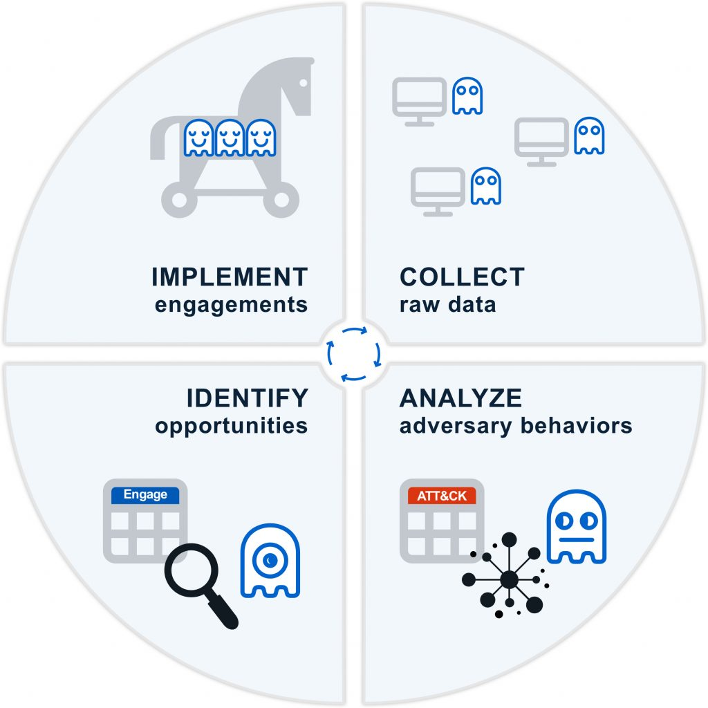
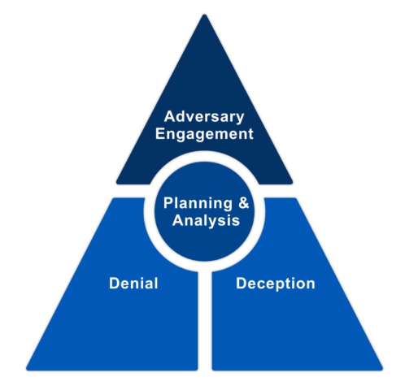
MITRE ENGAGE CYCLE
MITRE ENGAGE is a framework for planning and discussing adversary engagement operations that empowers you to engage your adversaries and achieve your cybersecurity goals.
MITRE has mainly these frameworks:
1.ATT&CK® (Adversarial Tactics, Techniques, and
Common Knowledge) Framework
2. CAR (Cyber Analytics Repository) Knowledge Base
3. ENGAGE
4. D3FEND (Detection, Denial ,and Disruption Framework Empowering Network Defense)
5. AEP (ATT&CK Emulation Plans)

Slide 6
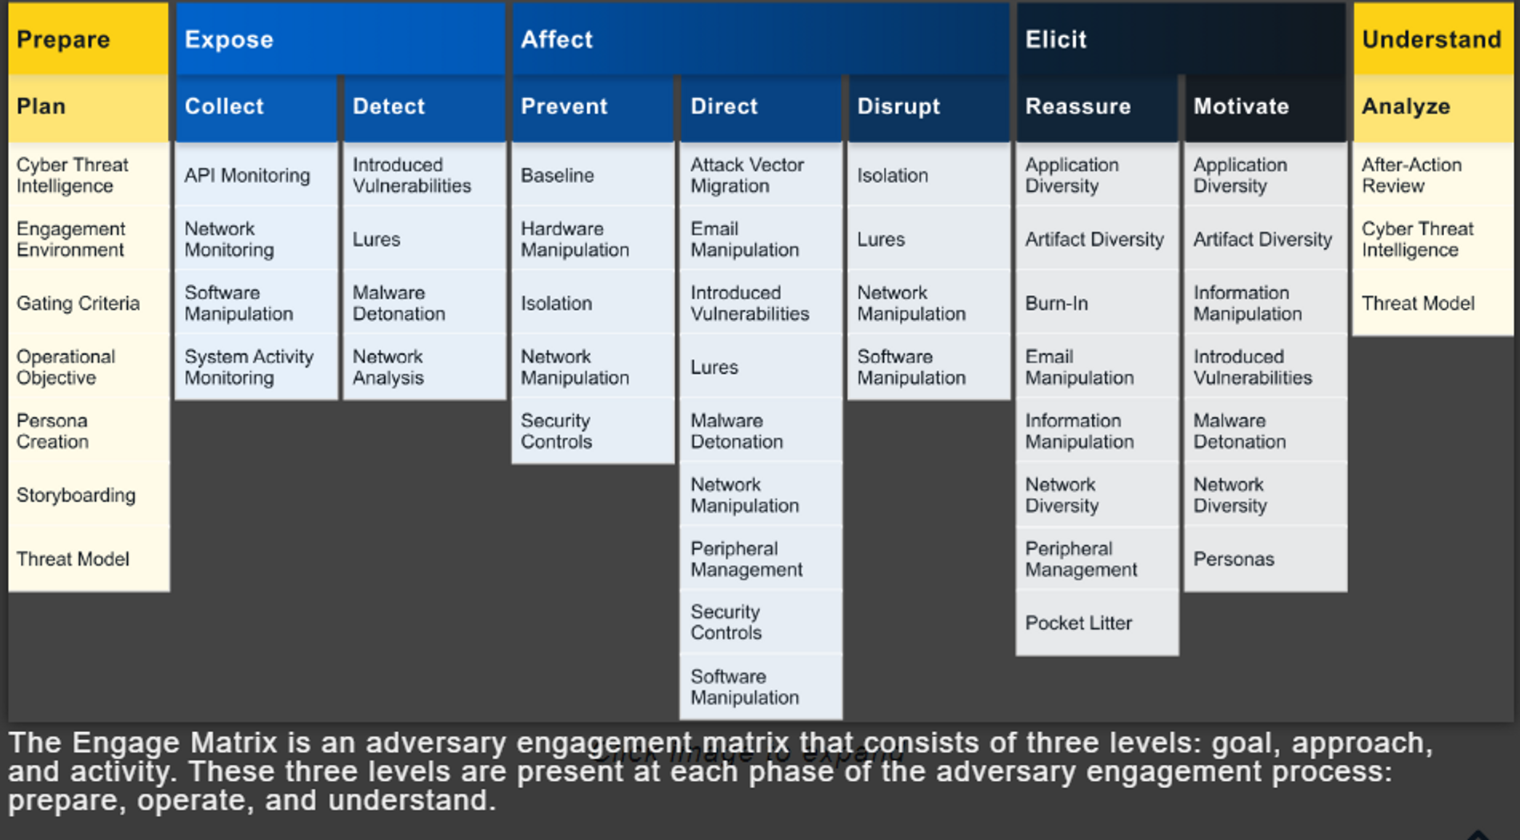
THE MITRE ENGAGE MATIX

Slide 7
Mitre attack stands for: ADVERSARY TACTICS TECHNIQUES COMMON KNOWLEDGE.
MITRE ATT&CK is a comprehensive knowledge base and framework for understanding and categorizing adversary behavior based on real-work observations of various phases of their attack lifecycle.

Slide 8






MITRE ATT&CK is available for 3 main domains which are Enterprise, Mobile, and ICS:
1. MITRE ATT&CK For Enterprise is focused on Windows, MacOS, and the Linux.
2. MITRE ATT&CK For Mobile is focused on Android and IOS.
3. MITRE ATT&CK For ICS is focused on ICS networks.

Slide 9
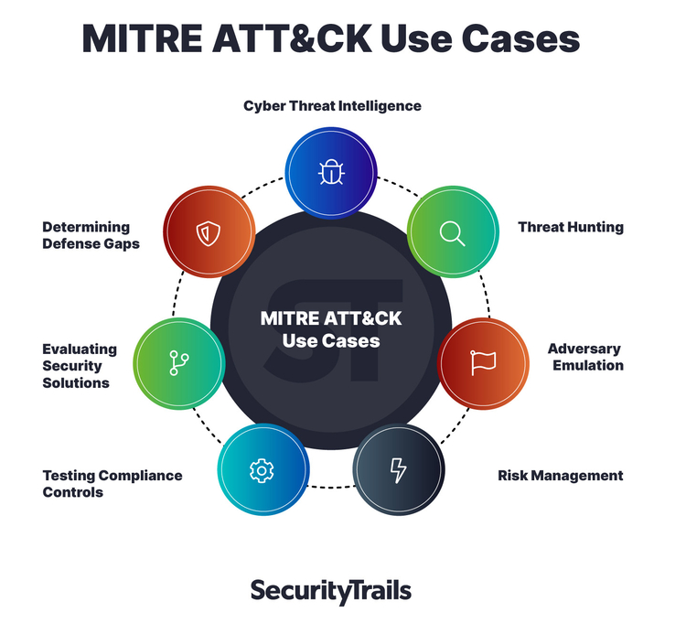
How organizations can use MITRE ATT&CK:
Throughout organizations in both the private and public sectors, the everyday activities of various teams benefit from applying ATT&CK's taxonomy. Red teams, blue teams, security operations center (SOC) analysts, threat hunters, incident responders and many other security professionals rely on the MITRE ATT&CK framework.
The MITRE ATT&CK framework shines brightest when organizations apply it to these use cases.

Slide 10
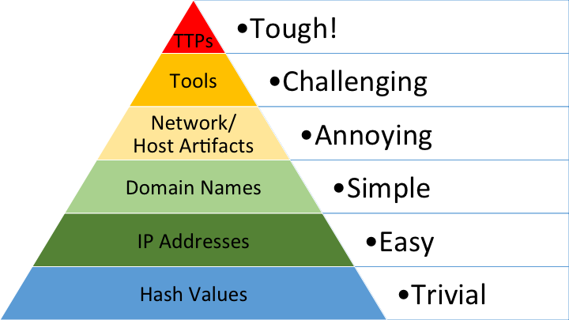
Types of Indicators
Hash Values: SHA1, MD5 or other similar hashes that correspond to specific suspicious or malicious files. These serve as unique fingerprints for files, aiding in malware identification. However, they can change significantly with even minor file alterations, making them less stable for detection.
IP Addresses: These are essential for network locations but are easily alterable by attackers, especially if they use tools like Tor or proxies. Blocking one IP address often doesn't hinder them significantly.
Domain Names: Web addresses, including subdomains, are relatively stable compared to IP addresses as they require registration and hosting. However, some DNS providers make domain switching feasible for attackers.
Network Artifacts: These are observable signs of adversary activity on a network, such as specific patterns in URIs or distinctive values in network protocols. Detecting and blocking network artifacts can disrupt malicious actions.
Host Artifacts: These are observable signs of adversary activities on host systems, like registry changes or specific file names. Responding to host artifacts can disrupt an attacker's operations on compromised systems.
Tools: Attackers use various software tools, like backdoors or password crackers. Blocking these tools forces attackers to find or develop new ones, consuming their time and resources.
Tactics, Techniques, and Procedures (TTPs): TTPs represent how adversaries execute their missions. For example, "spearphishing" is a common tactic for network entry. Disrupting TTPs forces attackers to change their entire approach, which can be highly disruptive to their operations.
The Pyramid of Pain:

Slide 11
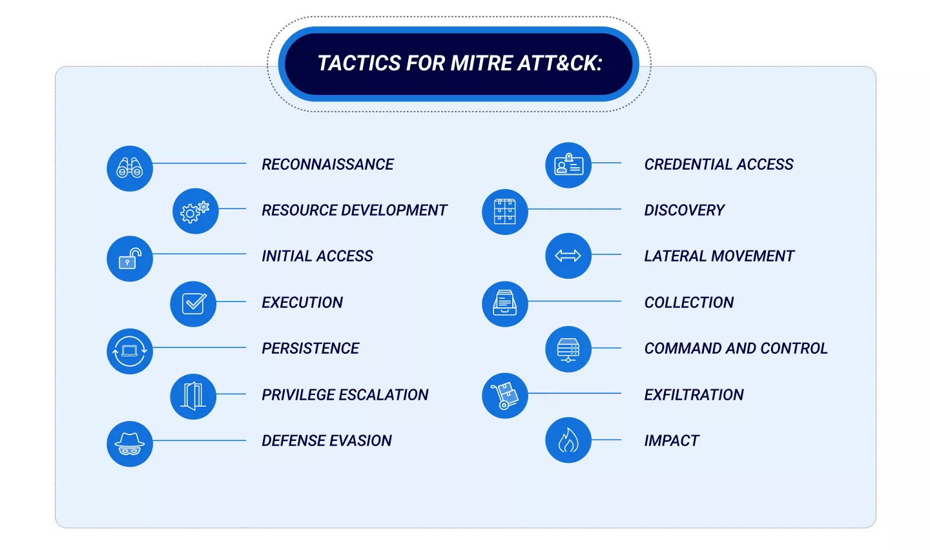
MITRE ATT&CK is a comprehensive knowledge base and framework for understanding and categorizing adversary behavior based on real-work observations of various phases of their attack lifecycle.

Slide 12
Each technique in the MITRE ATT&CK framework provides specific information:
ID: An identifier presented in the format "Txxx": for example, phishing is T1566 and sandbox evasion is T1497.
Sub-techniques: Refers to the more specific techniques, or distinct ways in which a technique is carried out by an adversary.
Tactic: The objective of the technique.
Platforms: Different platforms (Windows, Linux, macOS, cloud, etc.) to which the technique is applicable.
Data sources: Sources for information that can identify the technique, usually collected by a logging system.
Procedures: Specific ways in which threat groups used the technique to reach their objective.
Mitigation: Mitigation and defense strategies for the technique.
Detection: Methods for detecting adversaries on a network and indicators of compromise(IoC)

Slide 13
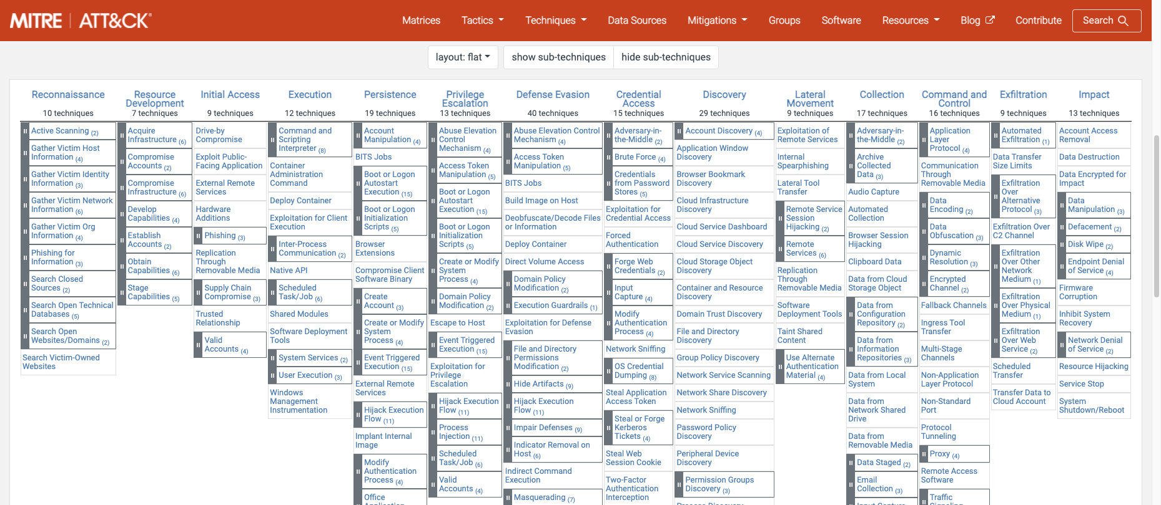
MITRE ATT&CK FOR ENTERPRISE MATRIX

Slide 14
ACTIVE SCANNING
SUB- TECHNIQUES:
ID | NAME
T1595.001 | Scanning IP Blocks
T1595.002 | Vulnerability Scanning
TI595.003 | Wordlist Scanning
Adversaries may execute active reconnaissance scans to gather information that can be used during targeting. Active scans are those where the adversary probes victim infrastructure via network traffic, as opposed to other forms of reconnaissance that do not involve direct interaction.
DETECTION: NETWORK TRAFFIC CONTENT
Monitor and analyze traffic patterns and packet inspection associated to protocol(s) that do not follow the expected protocol standards and traffic flows (eg. extraneous packets that do not belong to established flows, gratuitous or anomalous traffic patterns, anomalous syntax, or structure). Consider correlation with process monitoring and command line to detect anomalous processes execution and command line arguments associated to traffic patterns (e.g. monitor anomalies in use of files that do not normally initiate connections for respective protocol(s)).

Slide 15
GATHER VICTIM IDENTITY INFORMATION
SUB- TECHNIQUES:
ID | NAME
T1589.001 | Credentials
T1589.002 | Email Addresses
TI589.003 | Employee Names
Adversaries may gather information about the victim's identity that can be used during targeting. Information about identities may include a variety of details, including personal data (ex: employee names, email addresses, etc.) as well as sensitive details such as credentials.
DETECTION: NETWORK TRAFFIC CONTENT
Monitor for suspicious network traffic that could be indicative of probing for user information, such as large/iterative quantities of authentication requests originating from a single source (especially if the source is known to be associated with an adversary/botnet). Analyzing web metadata may also reveal artifacts that can be attributed to potentially malicious activity, such as user-agent string HTTP/S fields.

Slide 16
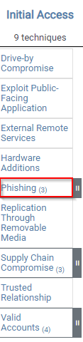
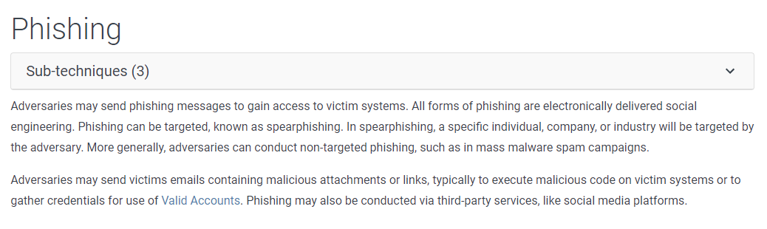
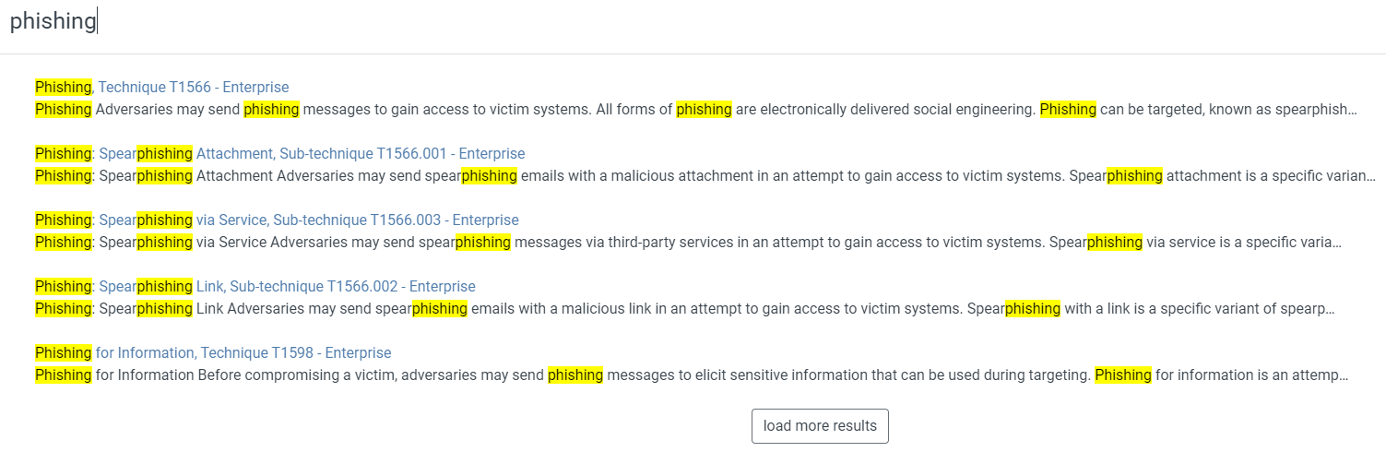
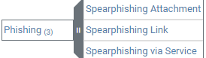
Under Initial Access, there are 9 techniques. Some of the techniques have sub-techniques, such as Phishing.

Slide 17


